Slide 1

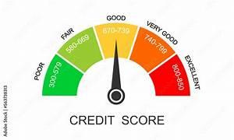
LLM-Based Credit Risk Assessment
Track 2: AI Credit Scoring System – Project Overview

Slide 2

Problem
How can a reliable and transparent LLM-based risk assessment method evaluate credit risk in AI-driven credit scoring systems?

Slide 3
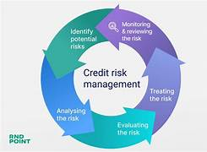
Solution
Build a prototype using a Large Language Model (LLM) that assesses credit risk for individuals or businesses.

Slide 4


Target Users
Individuals Companies/Businesses

Slide 5
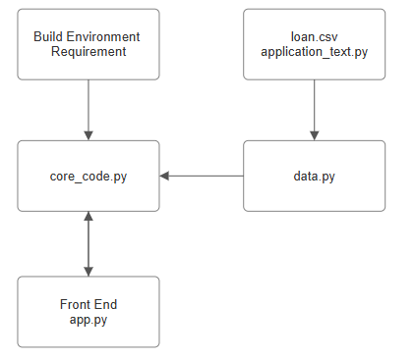
Diagram of components

Slide 6
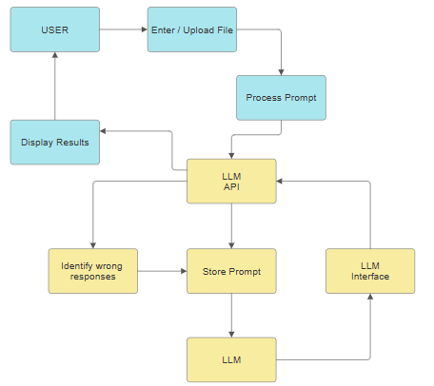
Data Flow
Boxes in blue = UI (User Interface) Boxes in yellow = process of programs

Slide 7
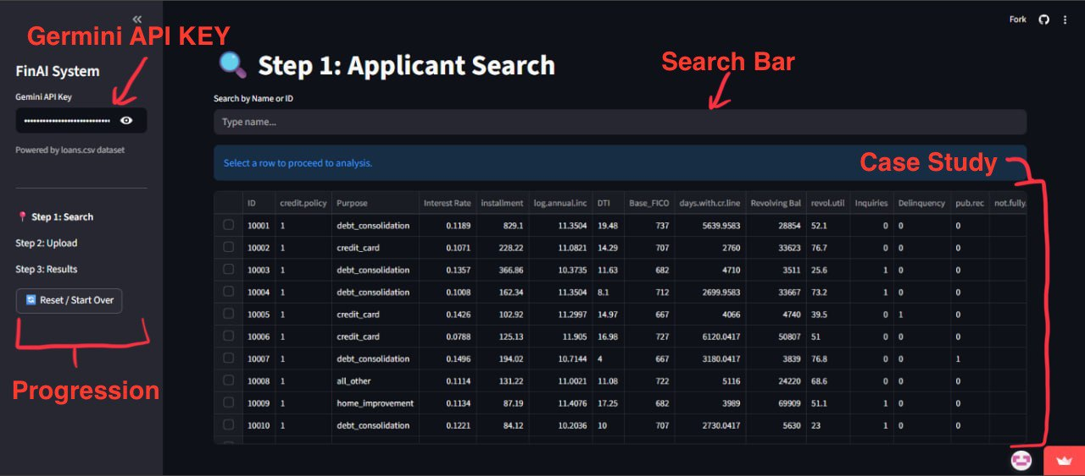
Main Function

Slide 8
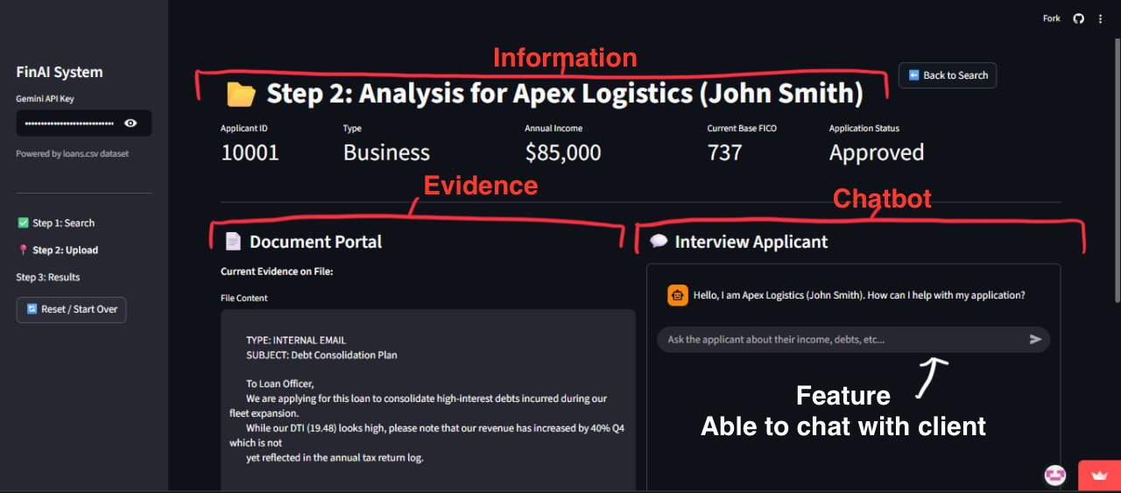
Main Function

Slide 9
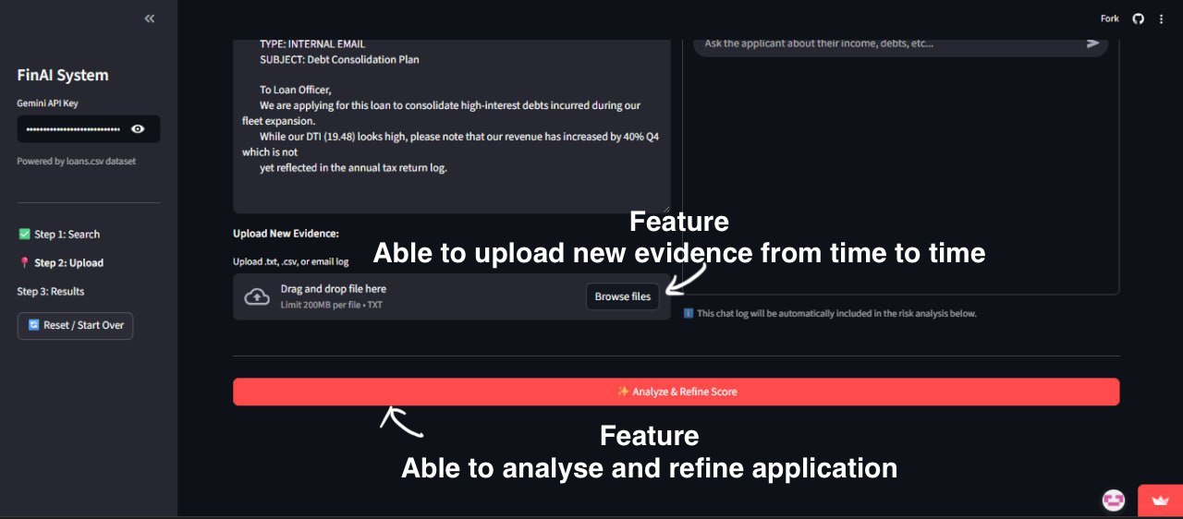
Main Function

Slide 10
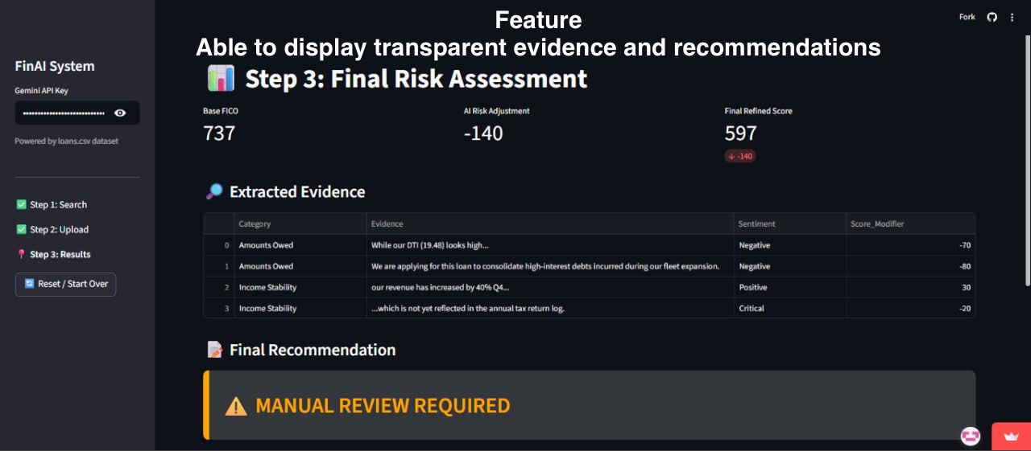
Main Function

Slide 11


Does this helps the society?

Slide 12
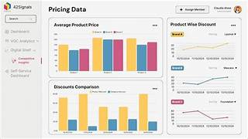


1. Improved Credit Decision-Making
Combines structured + unstructured data
Captures behavioral and textual risk factors
Reduces false approvals / unnecessary rejections

Slide 13
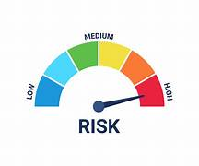

2. Effective Use of Text Data
LLM extracts sentiment and risk signals
Text is converted into useful risk features
More holistic and accurate predictions

Slide 14

3. Human Interpretability
Clear explanations generated by LLM
Highlighting important text cues
Display various important data

Slide 15


4. Dashboard Clarity
Clean UI with risk score visualization
Side-by-side structured + text insights
Downloadable reports and workflow integration

Slide 16
Conclusion
The LLM-based system provides:
More accurate credit scoring
Transparent explanations for regulatory compliance
A user-friendly dashboard for loan officers
A future-ready approach to financial risk assessment

Slide 17
Further Improvements (In the future)
Automated Chatbot with client to fact check more efficiently
Marked ‘Solved” for resolved case studies back at UI

Slide 18


